Slide 1
Wait-Less
A Program to Help Restaurants
Group22: Brian, Omar, Harsh, and Emmanuel

Slide 2

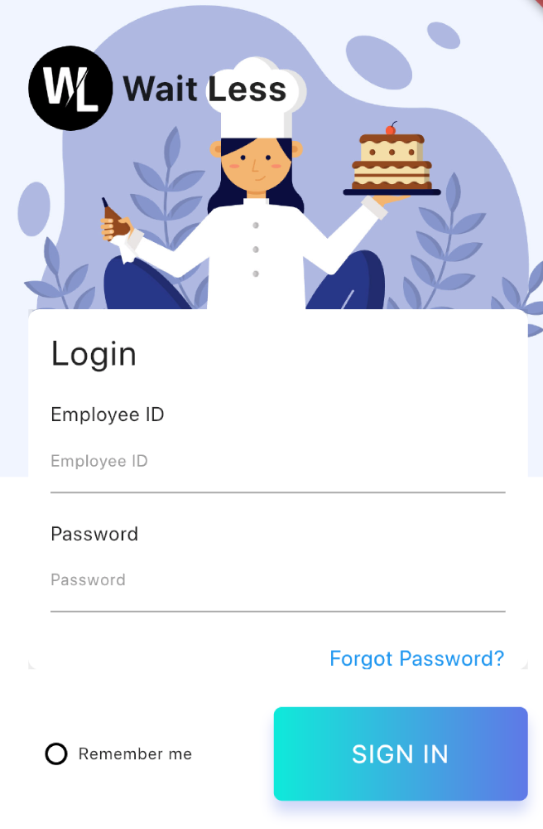
Wait-Less
Wait-Less is a mobile application that helps managers and employees handle a restaurant.
Allows waiters to easily manage and keep track of their tasks. As well as send tasks to other employees within the restaurant.
Allows managers to track progress and statistics of task and waiters

Slide 3

Frontend - UI Flutter
Same UI and Business Logic in All Platforms
Reduced Code Development Time
Increased Time-to-Market Speed
Custom, Animated UI of Any Complexity Available

Slide 4
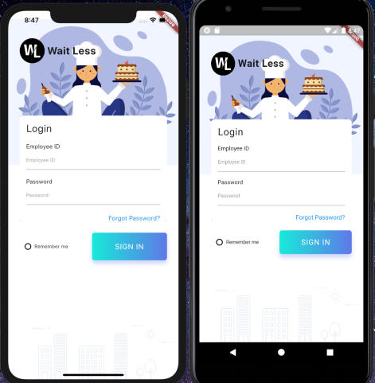
Cross Platform
Runs on both Android and iOS
Same code base
Identical UI

Slide 5
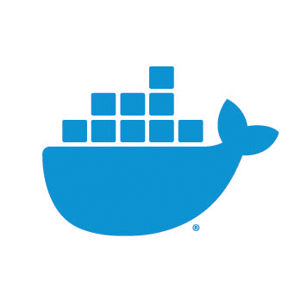
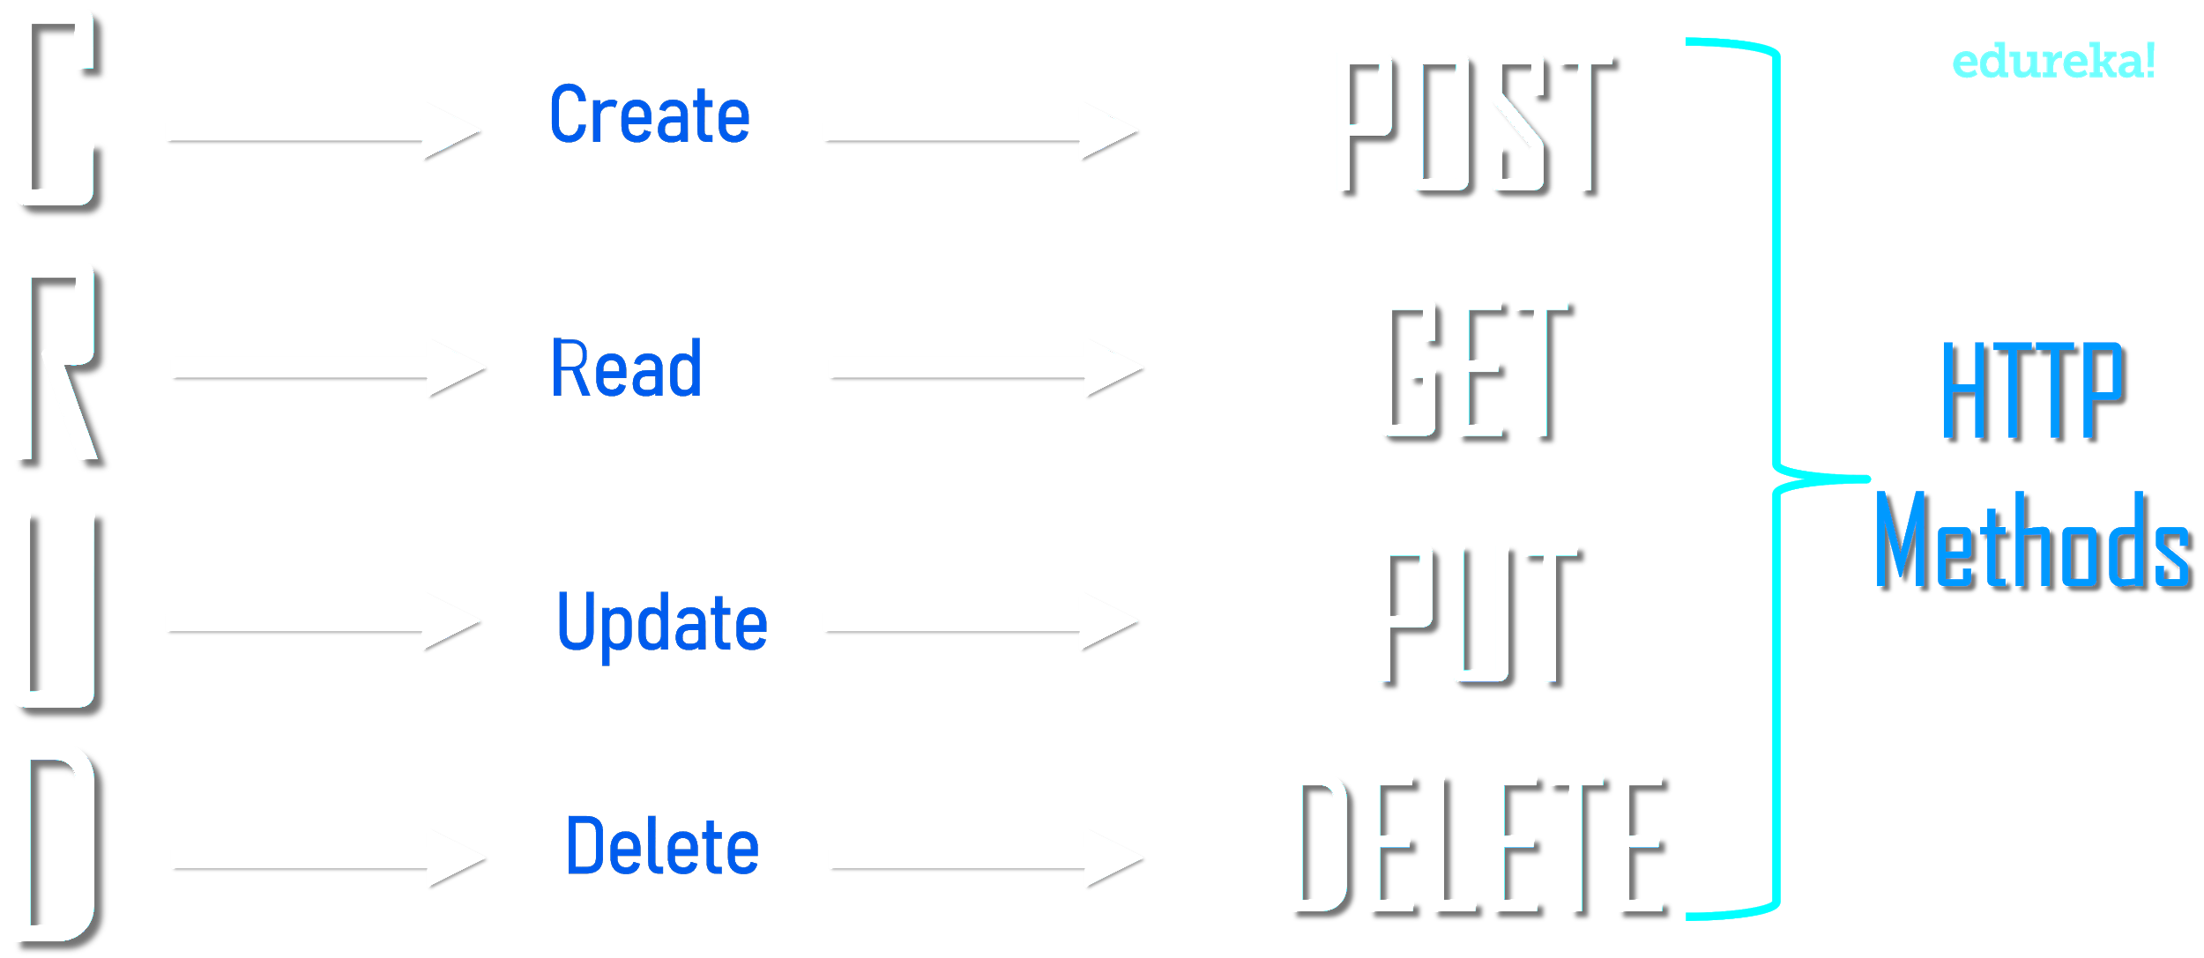
Back End
Front End makes REST HTTP requests to the backend to retrieve all data
Backend process requests and queries database to retrieve all necessary data
Business logic and algorithms all done on Backend
Spins up docker container to run integration tests against changes in the code base

Slide 6

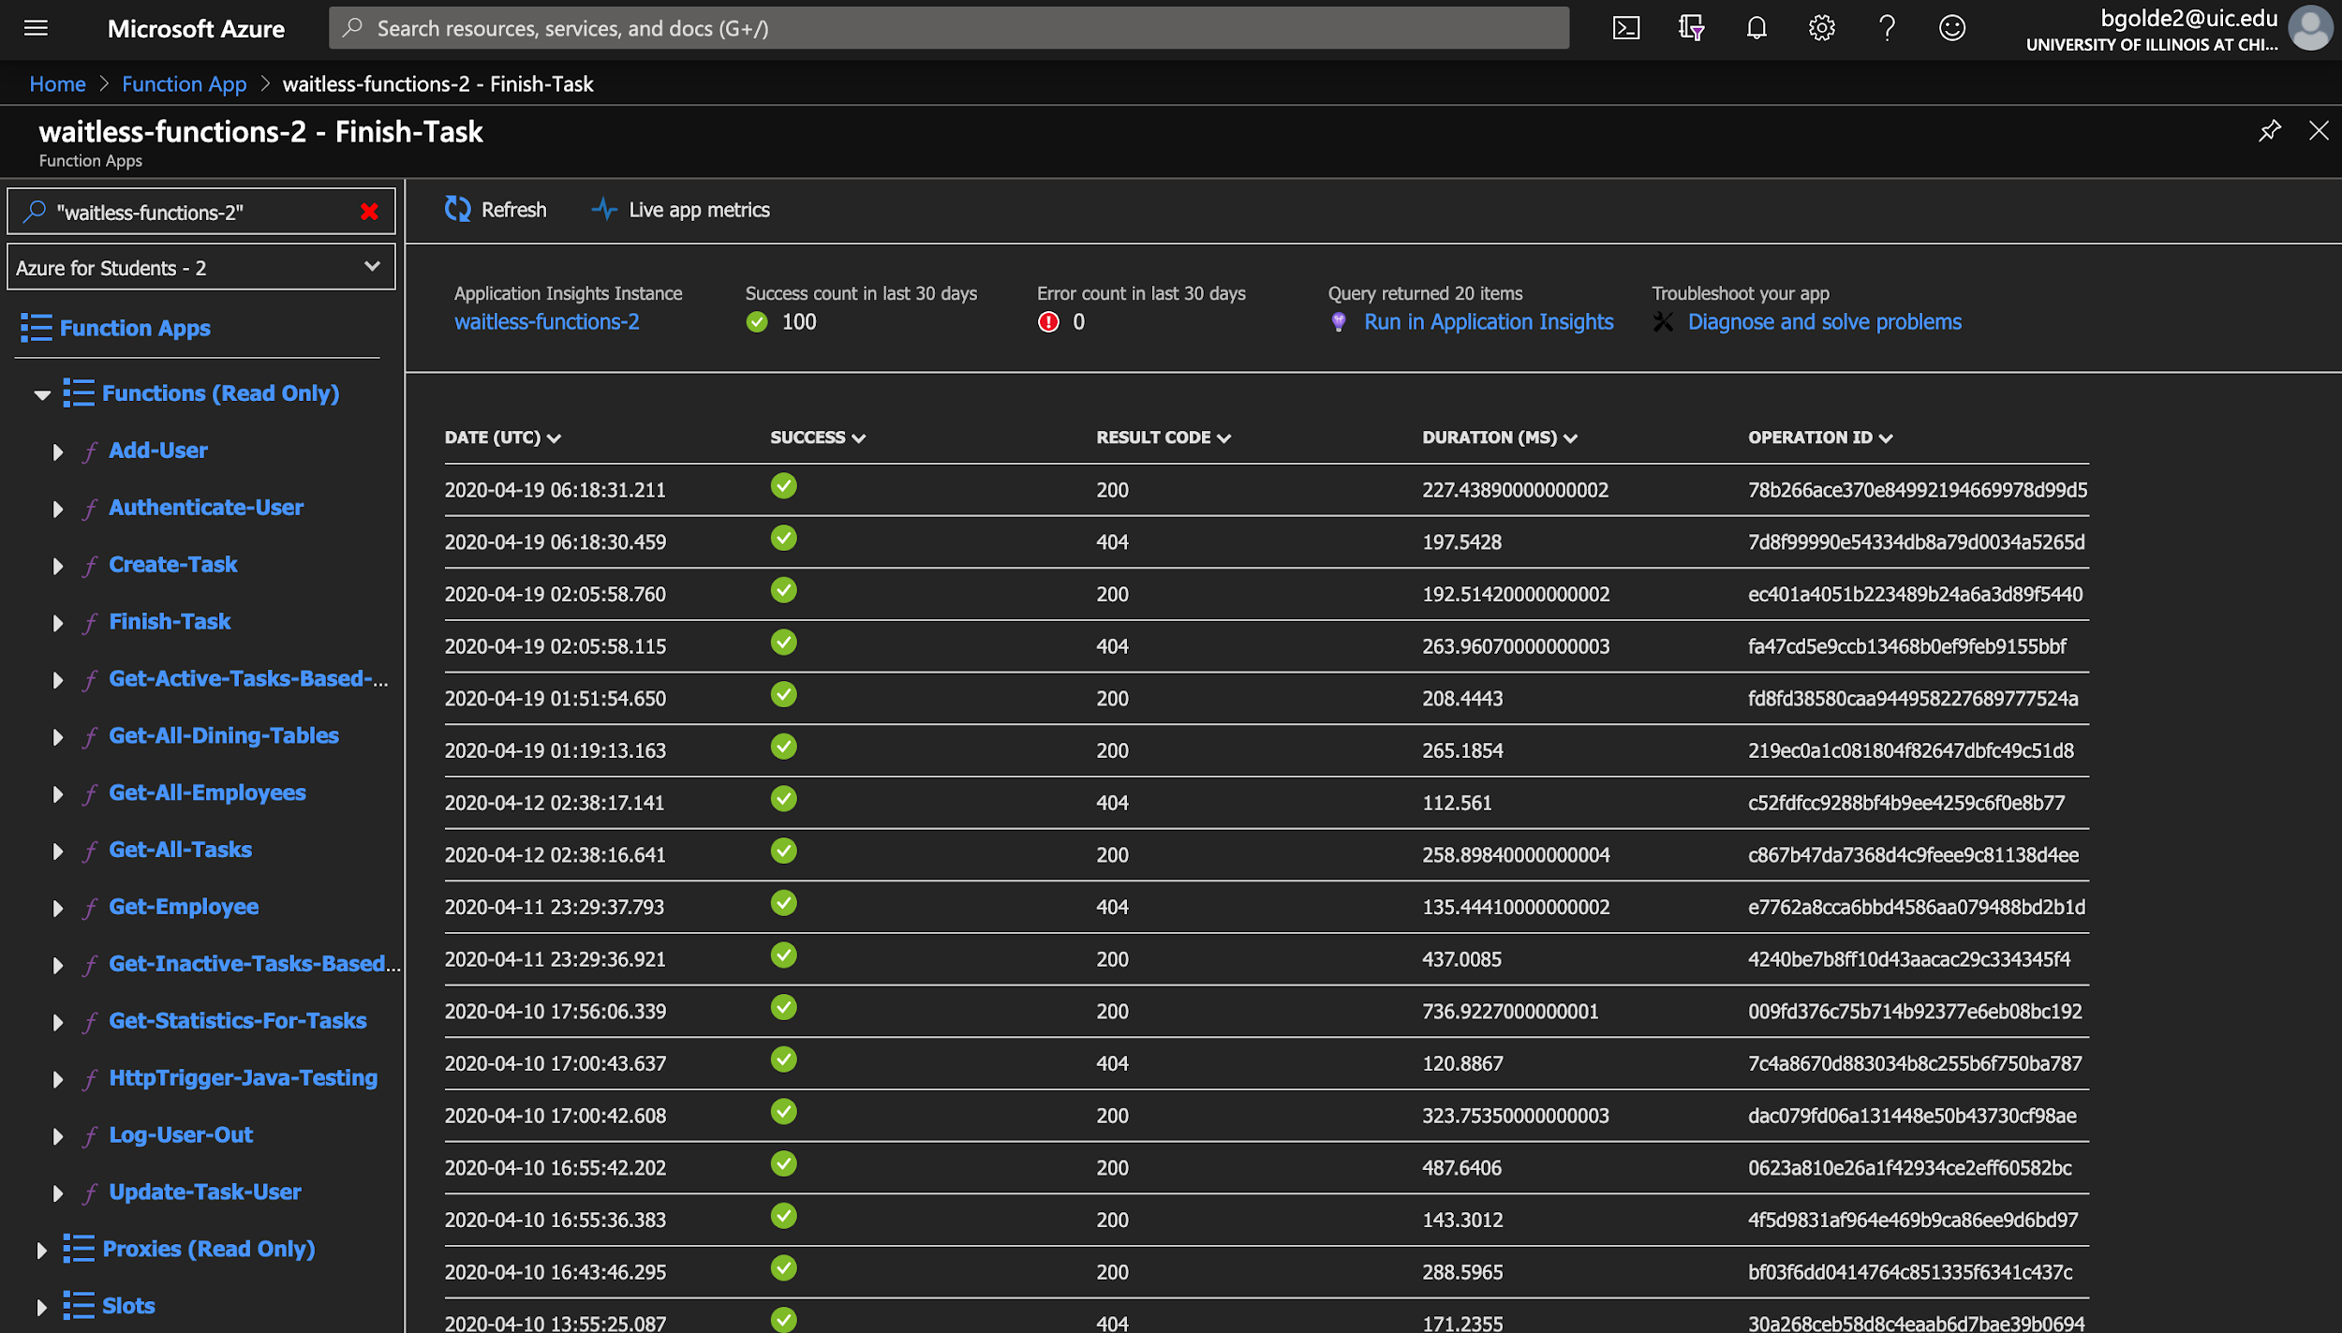
Azure
Backend runs on a Azure instance
Cloud event driven service
Monitor each individual functions
Created a CI/CD using GitHub Action
Runs unit and integration tests
Automatically deploys master code base to Azure

Slide 7
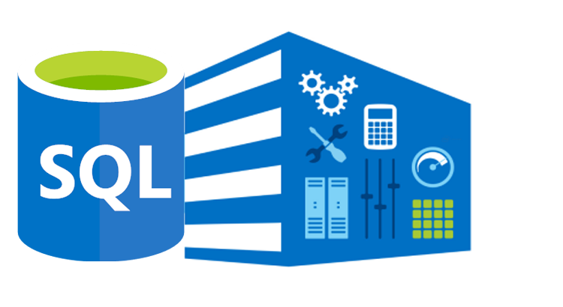
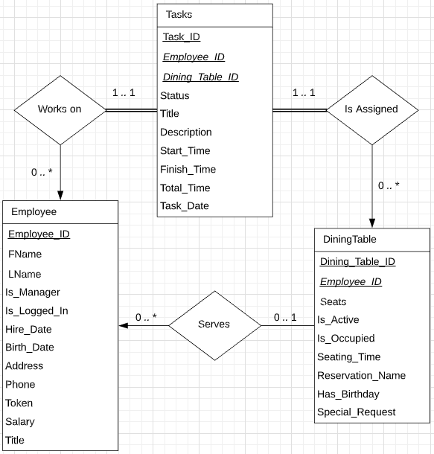
Database
MS SQL Server and Database
T-SQL building queries
Stored data for:
Employees
Restaurant Dining Tables
Tasks

Slide 8
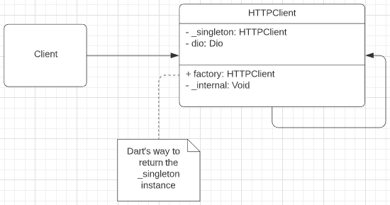
Frontend and Backend Communication
Using an HTTP Client library called Dio
Simple way to set connection configs like
Base URL
Connection Timeout
Receive Timeout
Singleton DP used since only 1 HTTP Client instance is needed

Slide 9
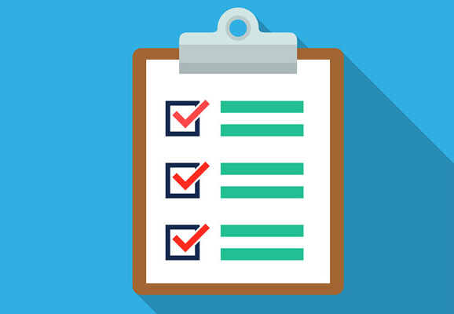
Test Suites
These tests perform actions on remote endpoints, as well as directly to SQL server.
User functionality tests
create, authenticate, get, getAll
Task functionality tests
create, finish, update, getX, getStats
Dining Table functionality tests
get, getAll
Tests are executed automatically for each build. This is in order to catch any erroneous changes made to the code base.

Slide 10

Task Sending and Completed Tasks Stats Demo

